Slide 1
One packer to rule them all
Empirical identification, comparison and circumvention of current Antivirus detection techniques
Arne Swinnen
Alaeddine Mesbahi

Slide 2
Agenda
Introduction
Packing 101
Static antivirus detection
Code emulation detection
Dynamic antivirus detection
Conclusion
Notes:
Cat & mouse game
Introduction: BruCON & Black Hat USA – technical security, take questions at the end

Slide 3


Who am I
Arne Swinnen
Security Consultant based in Belgium
@arneswinnen
https://www.arneswinnen.net
http://www.nviso.be
Alaeddine Mesbahi
Security Consultant based in France
@3asm_
http://yap0wnb.blogspot.fr
Notes:
Nviso website

Slide 4
Introduction

Slide 5
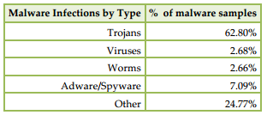
Malware is everywhere
“Malware Poisons One-Third of World's Computers”
- Anti-Phishing Working Group (APWG) @ August 2014 –
Notes:
Malware = huge problem

Slide 6
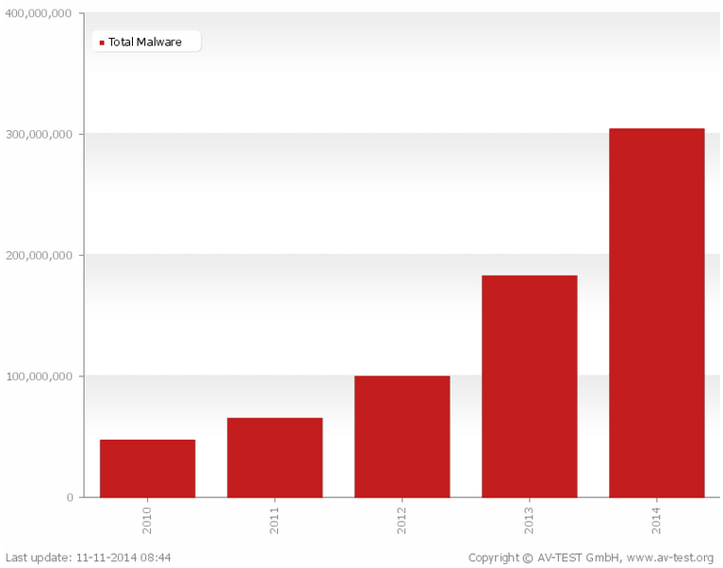
Malware increase
Notes:
Number of total malware samples x6 in 4 years (50.000 -> 300.000)

Slide 7
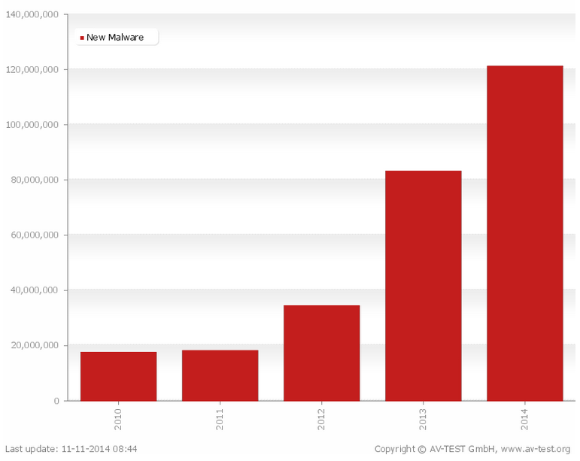
Malware increase ctd.
Notes:
Number of new malware samples x6 in 4 years (20.000-> 120.000).
Many malware are variations of existing malware, since creating a brand new malware costs a lot more.
Variation exists to evade anti-virus. Most prevalent method of varying is “packing”.

Slide 8
Packing 101

Slide 9

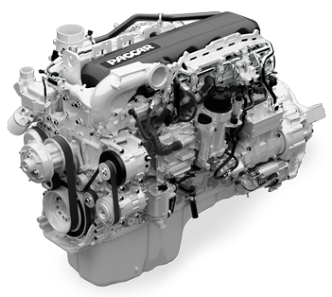

EP
STUB
Input
Output
OEP
Original executable aad3b435b51404eeaad3b435b51404ee
Packing Engine
Packed executable (output)
31d6cfe0d16ae931b73c59d7e0c089c0

Slide 10
Static AntiVirus detection

Slide 11
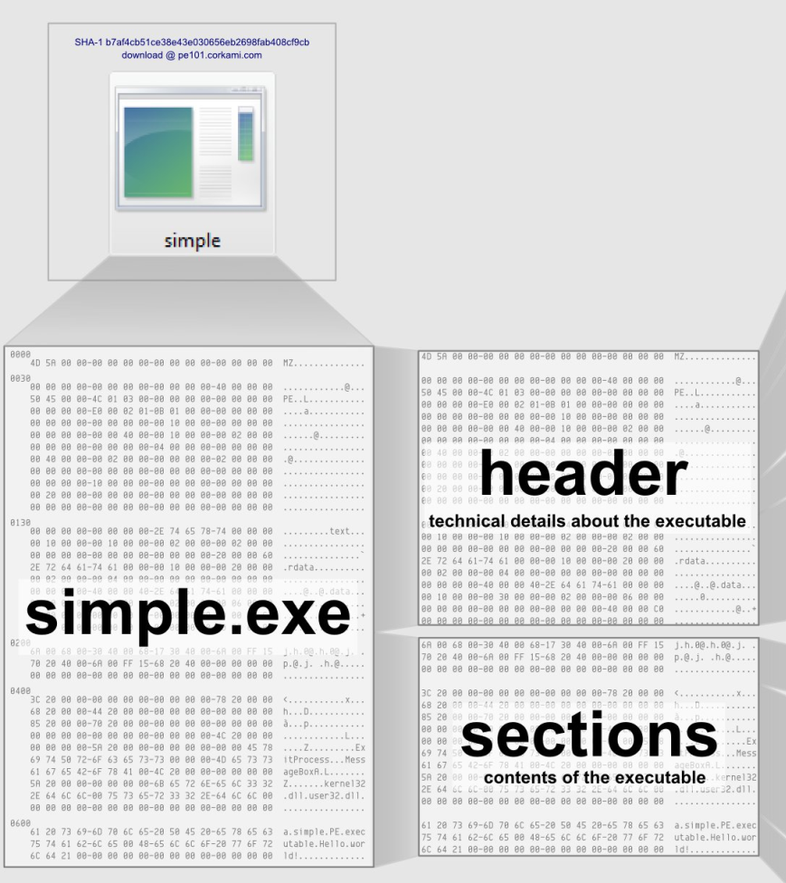
AddressOfEntryPoint
Sections table
Source: Corkami project

Slide 12

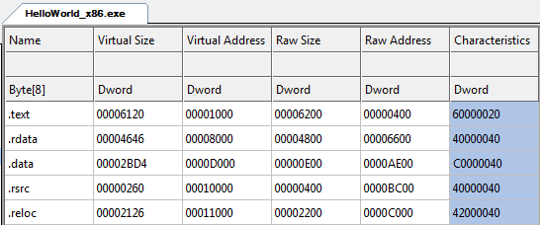
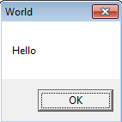
Entry Point
Notes:
Hello world box

Slide 13
Challenge 1: Extensible stub
Architecture-specific code
Position-independent code
Self-dependency resolution

Slide 14
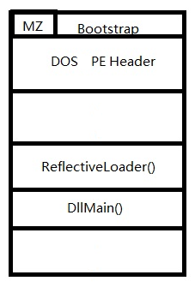
Solution
Reflective DLL injection is a library injection technique in which the concept of reflective programming is employed to perform the loading of a library from memory into a host process.
Injection works from Windows NT4 up to and including Windows 8, running on x86, x64 and ARM where applicable.
https://github.com/stephenfewer/ReflectiveDLLInjection

Slide 15
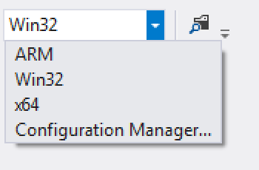
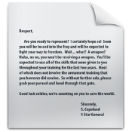

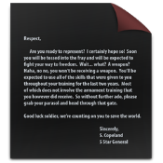
x86
.c
Loader
.c
.c
Stub
.h
.c
.h
.h
.h
.c
.c
.c
x64
.h
.c
.h
.h
.h
Loader
Stub

Slide 16

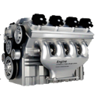


Initial Exe
Entry Point
Packing Engine
Packed Exe
Stub
Loader
Stub
Loader
Stub
Conf

Slide 17
Challenge 2: Stub injection
Hijack is easy: edit AddressOfEntryPoint
But how to inject the stub stealthy?
  Code section can’t be extended easily

Slide 18
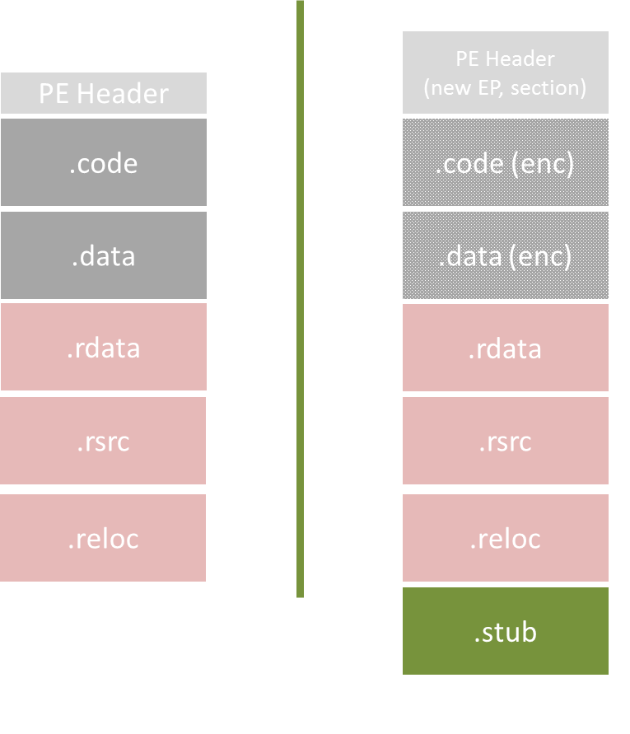
Inline

Slide 19
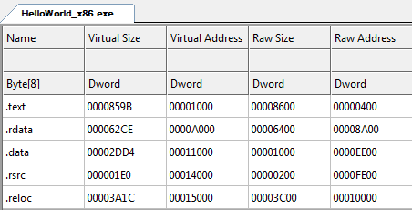
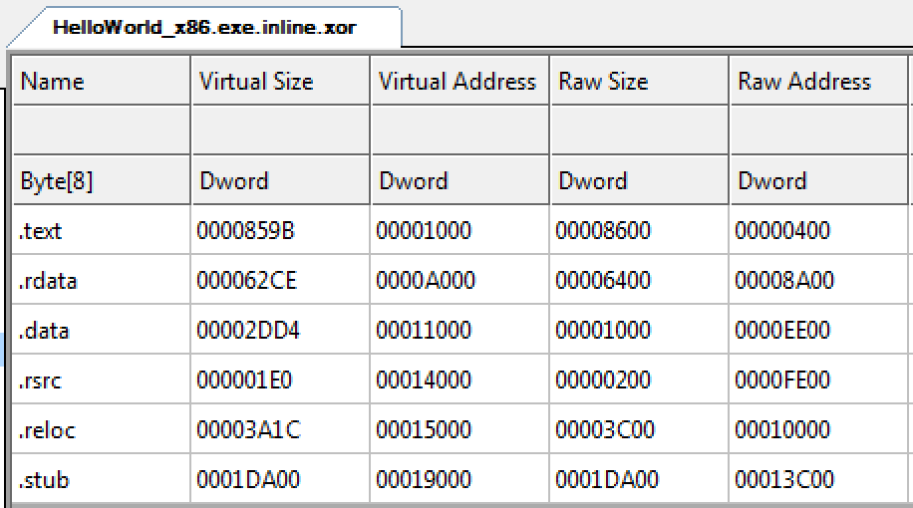
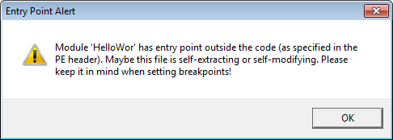
Inline

Slide 20
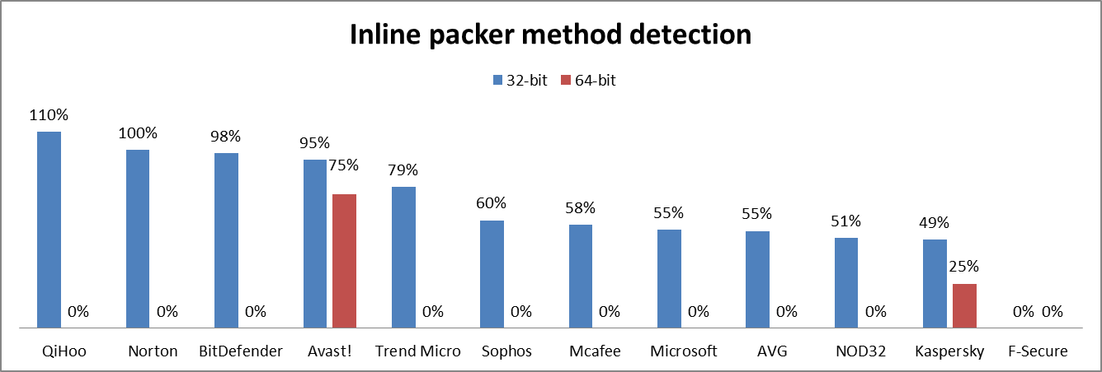
Inline

Slide 21
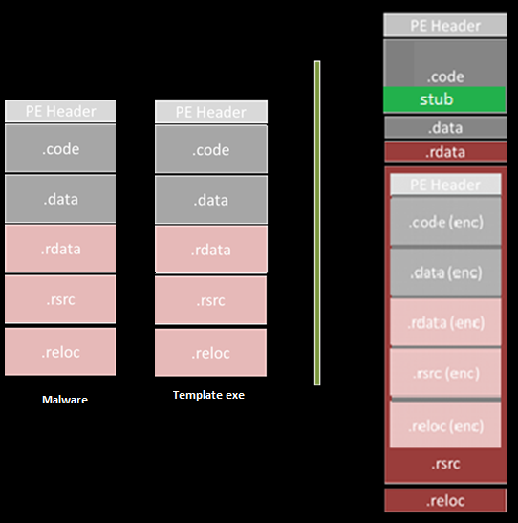
Resource

Slide 22
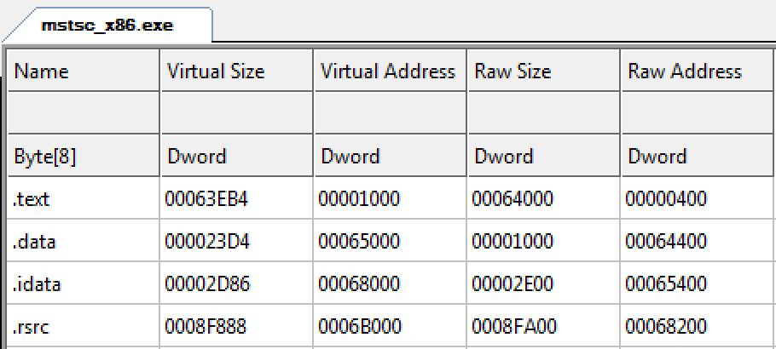
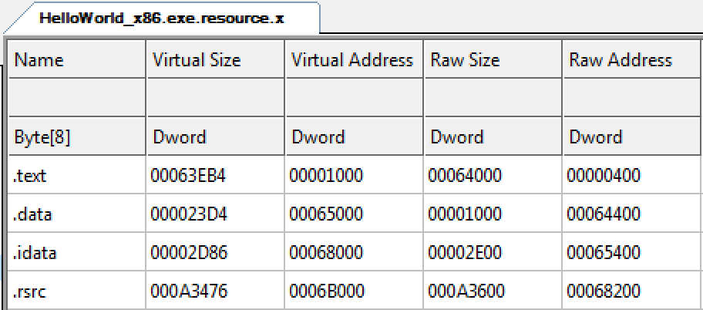
Resource

Slide 23
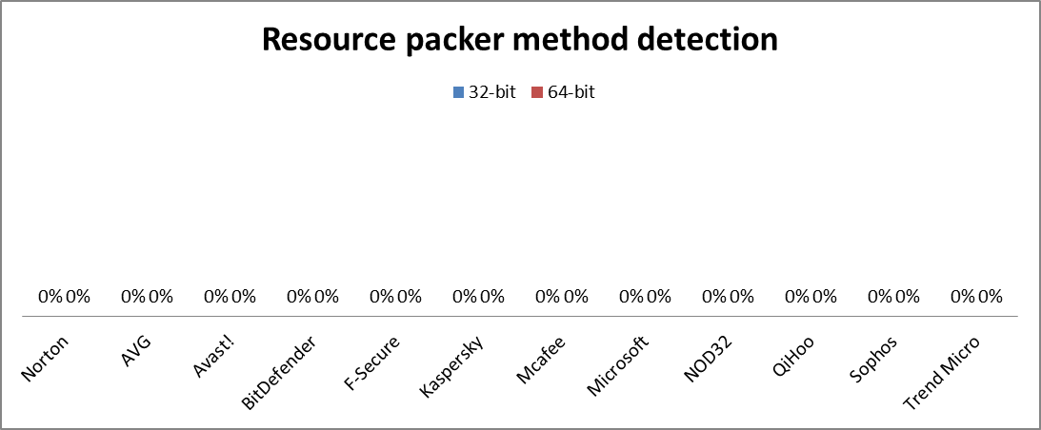
Resource

Slide 24
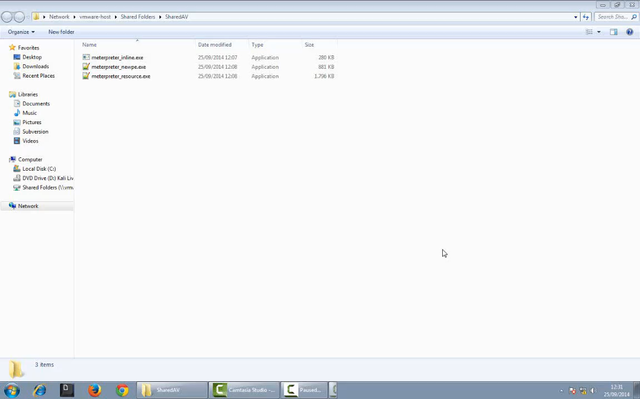

Slide 25
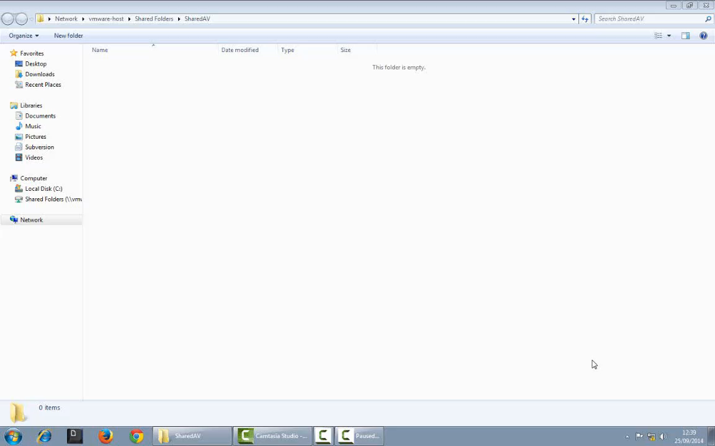

Slide 26
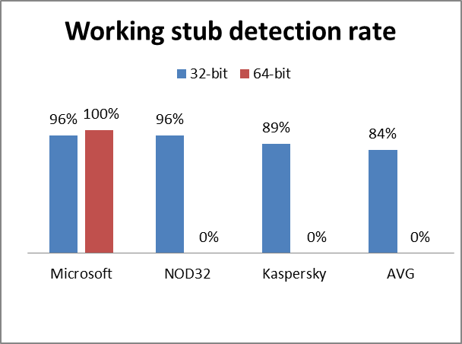
Code emulation detection
Notes:
Recap three detection techniques

Slide 27
Code emulation AntiVirus detection

Slide 28





Emulator

Slide 29
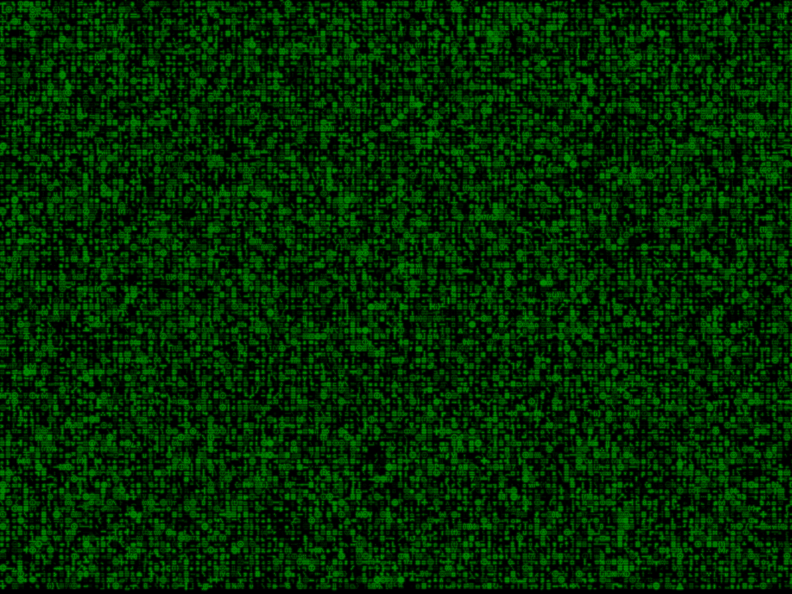
Emulated Memory
Emulator
Notes:
Purpose: detect packers et al

Slide 30

Method for accelerating hardware emulator used for malware detection and analysis
EP 2237186 B1
System and method for countering detection of emulation by malware EP 2713302 A1
Detecting malicious software by analyzing patterns of system calls generated during emulation
US 6775780 B
System and method for improving the efficiency of application emulation acceleration
EP 2750037 A1
System and method for detecting malware targeting the boot process of a computer using boot process emulation
US 8365297 B1
…

Slide 31
Time delaying & Anomaly Detection
Filesystem Interaction
Network Interaction
Dynamic Binary Instrumentation

Slide 32
Time 1
BOOL time1(){
//simply sleeps for a long time to delay payload decryption
Sleep(100000);
return FALSE;
}

Slide 33
Time 2
BOOL time2() {
DWORD tc1, tc2;
tc1 = GetTickCount();
Sleep(1000);
tc2 = GetTickCount();
tc2 = tc2-tc1;
//DebugBreak();
if(tc2 >= 1000)
{
return FALSE;
}
return TRUE;
}

Slide 34
Network 1
...
// Setup our socket address structure
SockAddr.sin_port=htons(445);
SockAddr.sin_family=AF_INET;
SockAddr.sin_addr.s_addr = inet_addr("127.0.0.1");
// Attempt to connect to server
if(connect(Socket,(SOCKADDR*)(&SockAddr),sizeof(SockAddr))!=0)
{
WSACleanup();
return TRUE;
}
Credits: @FunOverIP

Slide 35
Filesystem 3
...
for(int i=0; i<(sizeof(realDLL)/sizeof(*realDLL)); i++) {
//printf("%s\n", realDLL[i]);
hInstLib = LoadLibraryA( realDLL[i] );
if(hInstLib == NULL) return TRUE;
FreeLibrary(hInstLib);
}
for(int i=0; i<(sizeof(falseDLL)/sizeof(*falseDLL)); i++) {
//printf("%s\n", falseDLL[i]);
hInstLib = LoadLibraryA( falseDLL[i] );
if(hInstLib != NULL)
return TRUE;
}

Slide 36
Binary Instrumentation 1
...
GetNameByPid(procentry.th32ParentProcessID, ProcName, sizeof(ProcName));
if(strcmp("explorer.exe", ProcName) && strcmp("cmd.exe", ProcName))
return TRUE;
else
return FALSE;
...
Credits: Francisco Falcón and Nahuel Riva

Slide 38
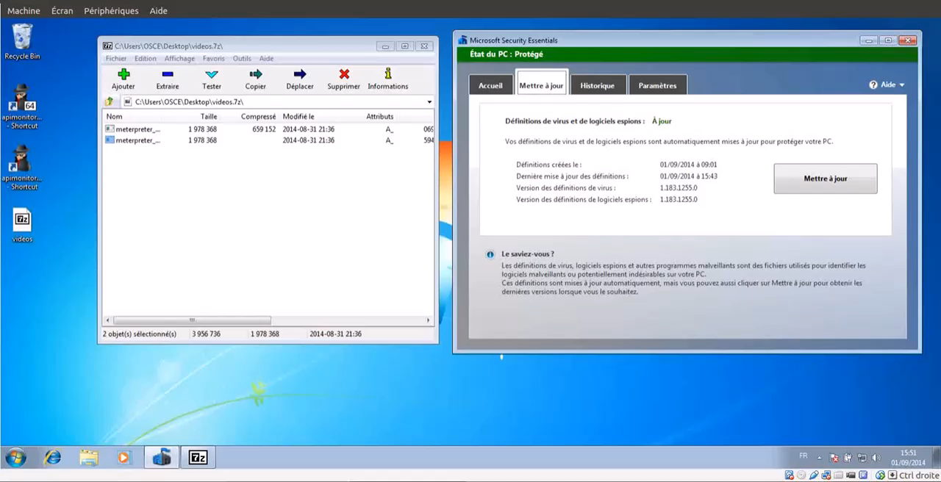

Slide 39
Heuristic/Dynamic Antivirus detection

Slide 40
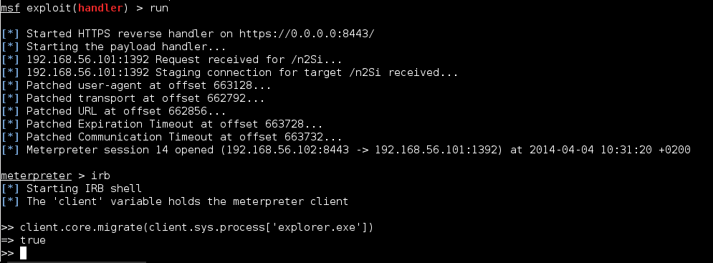
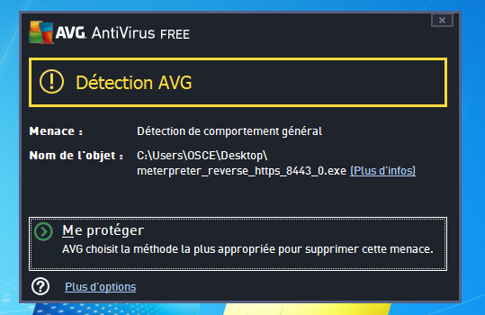
Notes:
TODO: replace with animation

Slide 41


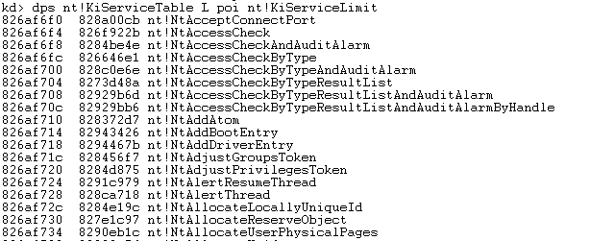


USER LAND
Kernel32.dll
CreateFileW
Ntdll.dll
…
SSDT
KERNEL LAND
ZwCreateFileW
Procmon.sys

Slide 42
DWORD dwResult = NtUnmapViewOfSection(
pProcessInfo->hProcess,
pPEB->ImageBaseAddress);
...
PVOID pRemoteImage = VirtualAllocEx(
pProcessInfo->hProcess,
pPEB->ImageBaseAddress,
pSourceHeaders->OptionalHeader.SizeOfImage,
MEM_COMMIT | MEM_RESERVE,
PAGE_EXECUTE_READWRITE);
...
WriteProcessMemory(
pProcessInfo->hProcess,
pPEB->ImageBaseAddress,
pBuffer,
pSourceHeaders->OptionalHeader.SizeOfHeaders,
0);

Slide 43
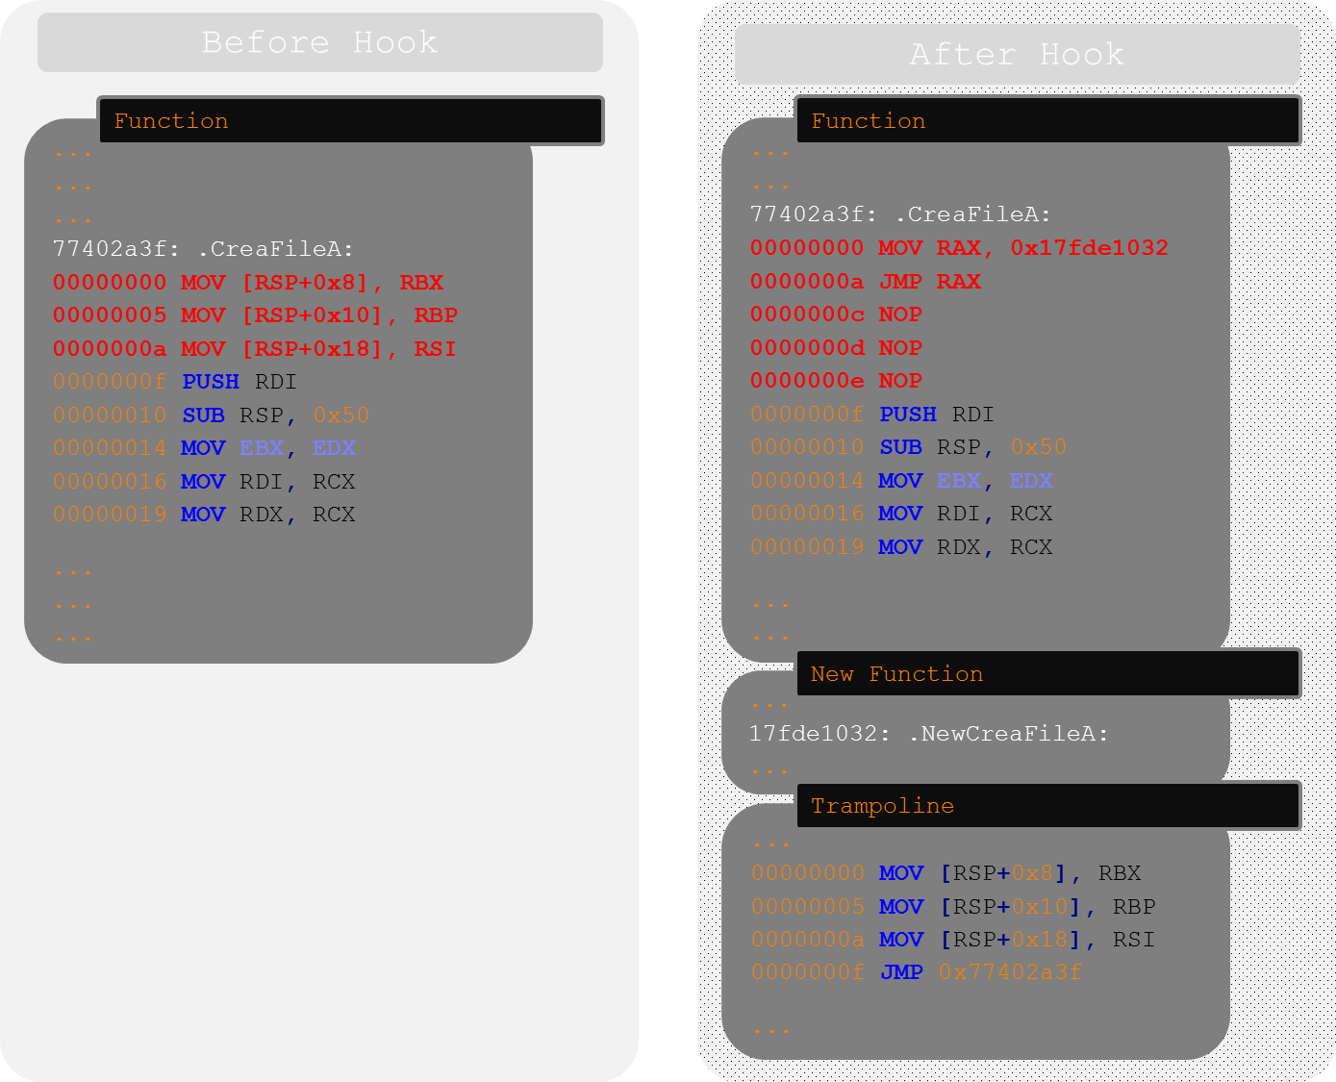
Notes:
Replace with a demo

Slide 44
Before
..[SNIP]..
RegOpenKeyExW(hKey, lpSubKey, ulOptions, samDesired, phkResult);
..[SNIP]..
After
char lcCommand[256];
if(*(rrs->hRegKeyRes) == hKey){
if(rrs->hRegKey == HKEY_CLASSES_ROOT)
sprintf_s(clClass, "%s", "HKCR");
..[SNIP]..
if(dwType == REG_NONE)
{
sprintf_s(clType, "%s", "REG_NONE");
}
..[SNIP]..
sprintf_s(lcCommand, "reg add %s\\%ws /v \"%ws\" /t %s /d \"%ws\" /f", clClass, rrs->lpKeyName, lpValueName, clType, lpData);
system(lcCommand);

Slide 45
DWORD dwResult = NtUnmapViewOfSection(
pProcessInfo->hProcess,
pPEB->ImageBaseAddress);
...
NtUnmapViewOfSection(…)
VirtualAllocEx(…)
VirtualProtect(…)
WriteProcessMemory(…)
VirtualAllocEx(…)
...
PVOID pRemoteImage = VirtualAllocEx(
pProcessInfo->hProcess,
pPEB->ImageBaseAddress,
pSourceHeaders->OptionalHeader.SizeOfImage,
MEM_COMMIT | MEM_RESERVE,
PAGE_EXECUTE_READWRITE);
...
NtUnmapViewOfSection(…)
VirtualAllocEx(…)
VirtualProtect(…)
WriteProcessMemory(…)
VirtualAllocEx(…)
...

Slide 46
 | Generic | Complexity | Performance
API Translation
API Junk Injection

Slide 47
Conclusion

Slide 48
Detection techniques
Evolution of detection methods
Code Emulation is powerful but complex
Heuristic is powerful and could be difficult to bypass in a generic approach
Need to explore new avenues: Machine Learning, Cloud based AV, …

Slide 49
Take away
Anti-virus products are good for known malware, but weak against variations and new malware
Think of Anti-virus product as one layer of defense, but certainly not the only one
Increase rapid detection of uncaught malware by focusing on other Indicators of Compromise (IOC)
Notes:
Anti-virus evasion:
easy: no
Possible: yes
Why? Investigate
Conclusion of anti-virus: Good layer, but take other measures

Slide 50
Questions?

Slide 51
Thank you!

