Slide 1
One packer to rule them all
Empirical identification, comparison and circumvention of current Antivirus detection techniques
Arne Swinnen
Alaeddine Mesbahi

Slide 2
Agenda
Packing 101
Static antivirus detection
Code emulation detection
Dynamic antivirus detection

Slide 3


Who are we
Arne Swinnen
Security Consultant based in Belgium
@arneswinnen
http://www.arneswinnen.net
Alaeddine Mesbahi
Security Consultant based in France
@3asm_
http://yap0wnb.blogspot.fr

Slide 4
Packing 101

Slide 5

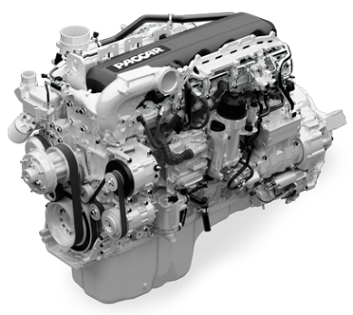

EP
STUB
Input
Output
OEP
Original executable aad3b435b51404eeaad3b435b51404ee
Packing Engine
Packed executable (output)
31d6cfe0d16ae931b73c59d7e0c089c0

Slide 6



UPX, FSG, PECompact, MEW, MPRESS, Upack, …
3.1415 MB
Compressor
2.7282 MB

Slide 7
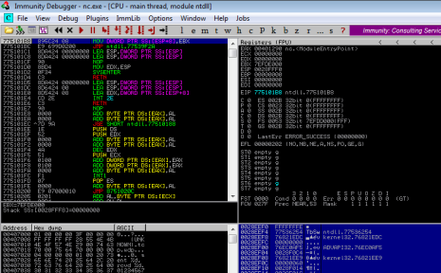
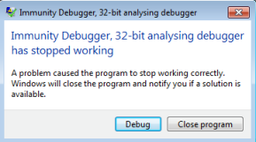
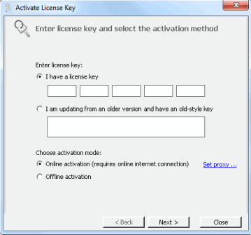
UPX, FSG, PECompact, MEW, MPRESS, Upack, …
3.1415 MB
Compressor
2.7282 MB
PELock, PESpin, Armadillo - SoftwarePassport (R.I.P.), Thermida , VMProtect, ...
Obfuscator
Protector

Slide 8
Static AntiVirus detection

Slide 9
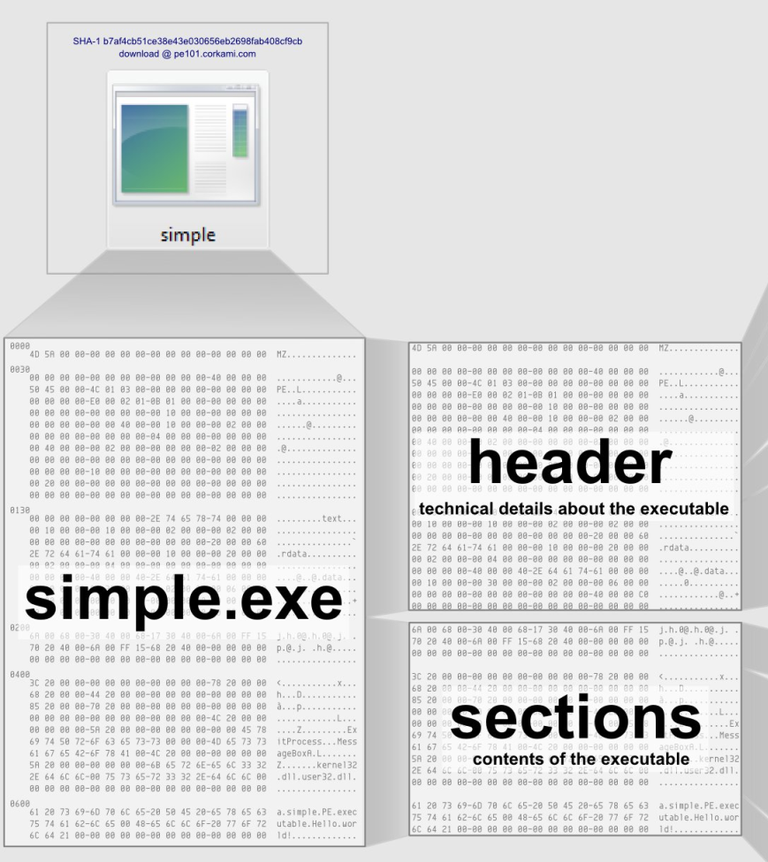
AddressOfEntryPoint
Sections table
Source: Corkami project

Slide 10

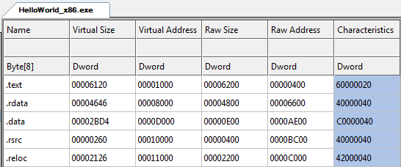
Entry Point

Slide 11
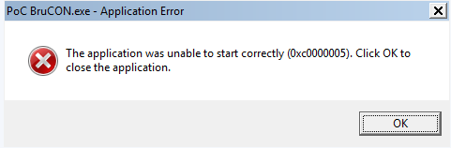
Entry Point
Can’t be encrypted

Slide 12

Entry Point
Can’t be moved
Can be moved

Slide 13
Challenge 1: Extensible stub
Architecture-specific code
Position-independent code
Self-dependency resolution

Slide 14
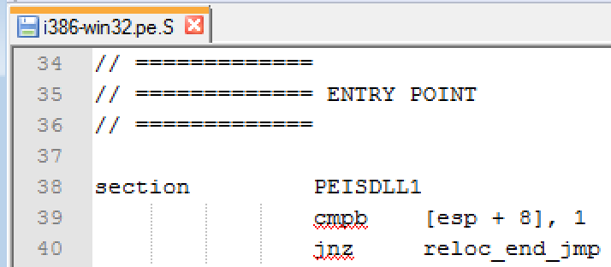
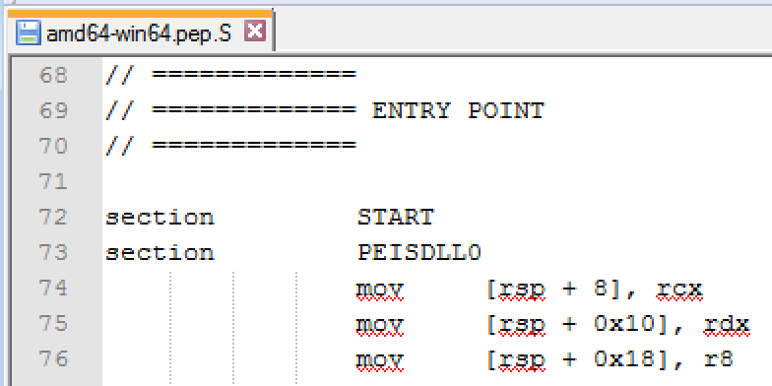
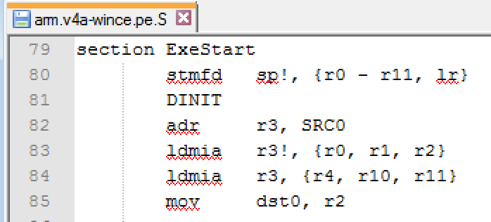
UPX
upx-3.91-src\src\stub\src\

Slide 15
UPX
upx-3.91-src\src\stub\src\
→ Think shellcode, but without restrictions

Slide 16
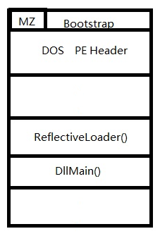
Solution
Reflective DLL injection is a library injection technique in which the concept of reflective programming is employed to perform the loading of a library from memory into a host process.
Injection works from Windows NT4 up to and including Windows 8, running on x86, x64 and ARM where applicable.
https://github.com/stephenfewer/ReflectiveDLLInjection

Slide 17
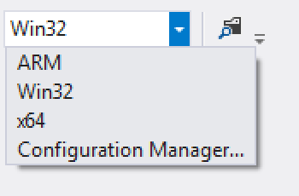
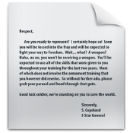


x86
.c
Loader
.c
.c
Stub
.h
.c
.h
.h
.h
.c
.c
.c
x64
.h
.c
.h
.h
.h
Loader
Stub

Slide 18

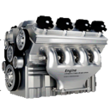


Initial Exe
Entry Point
Packing Engine
Packed Exe
Stub
Loader
Stub
Loader
Stub
Conf

Slide 19
Process Memory
Heap
Loader
Stub
Loader
Stub
Conf
Conf
First stage

Slide 20
Process Memory
Heap
Loader
Stub
Conf
Second stage

Slide 21
Challenge 2: Stub injection
Hijack is easy: edit AddressOfEntryPoint
But how to inject the stub stealthy?
  Code section can’t be extended easily

Slide 22
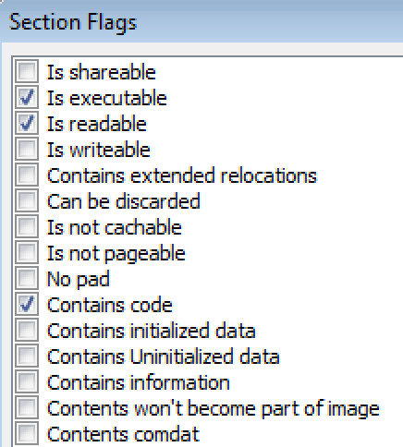
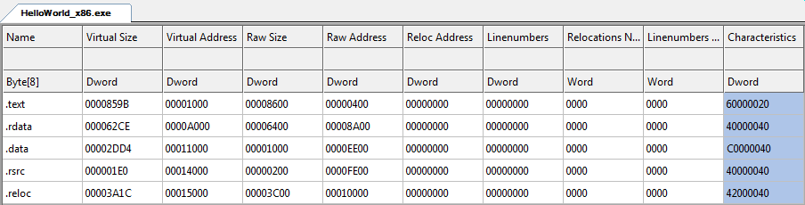
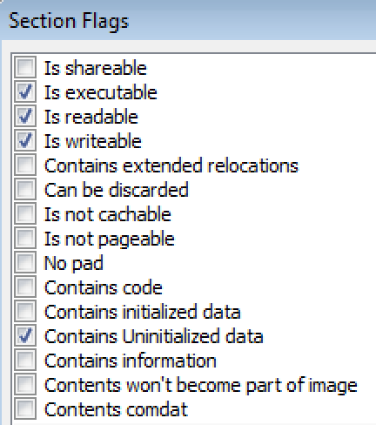
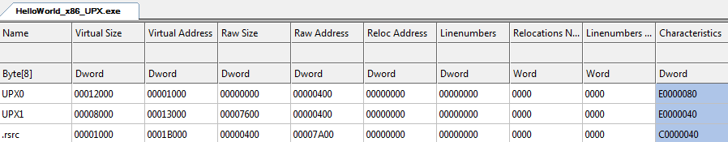
UPX

Slide 23
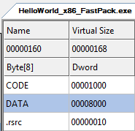
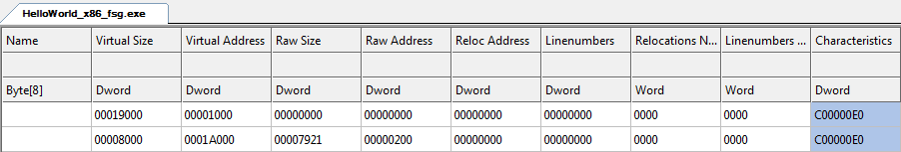
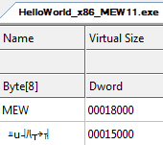
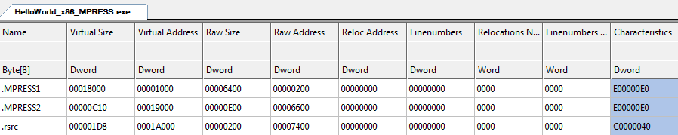
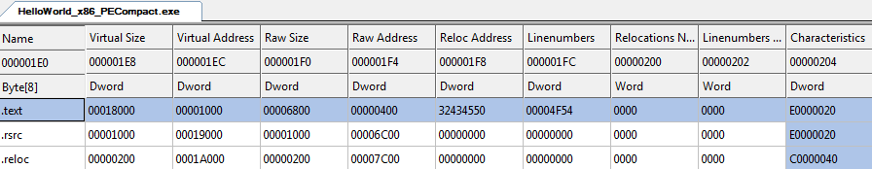
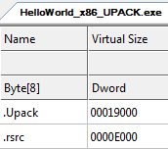
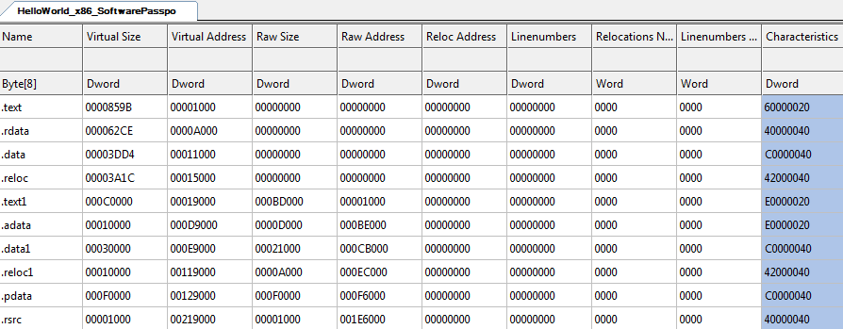
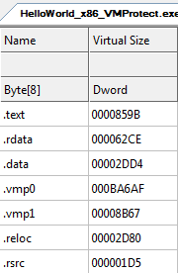
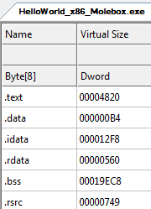
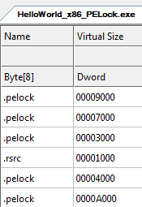
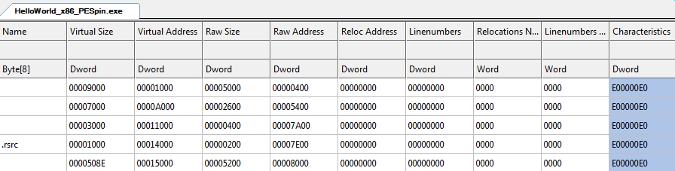
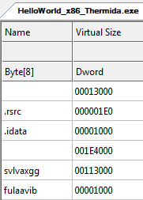
Fastpack FSG MEW MPRESS PECompact UPACK
Molebox PELOCK PESpin Software Thermida VMProtect
Passport

Slide 24
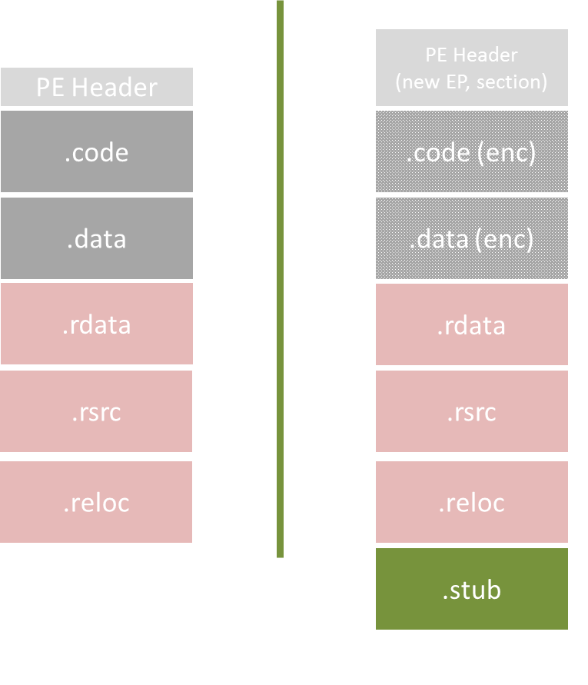
Inline

Slide 25
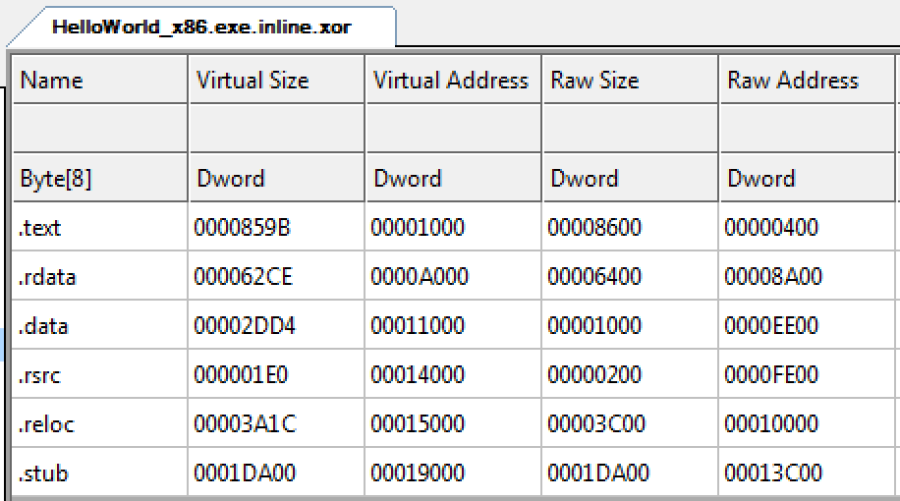
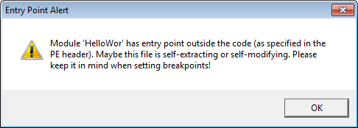
Inline

Slide 26
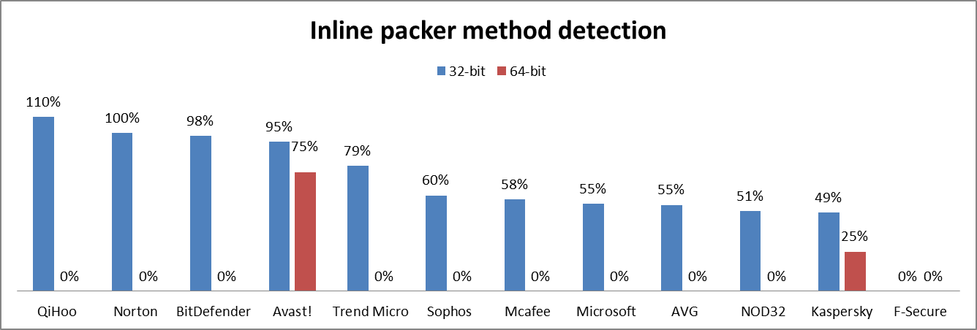
Inline

Slide 27
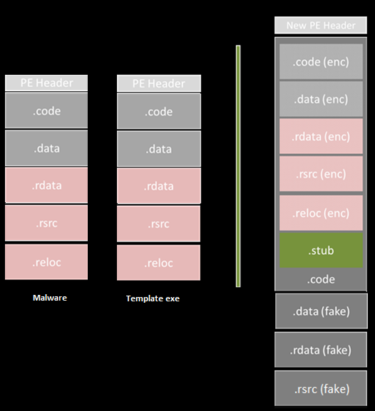
NewPE

Slide 28
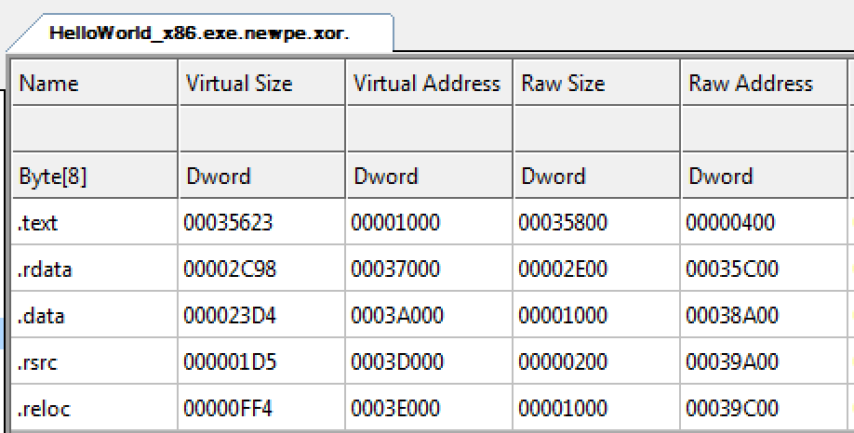
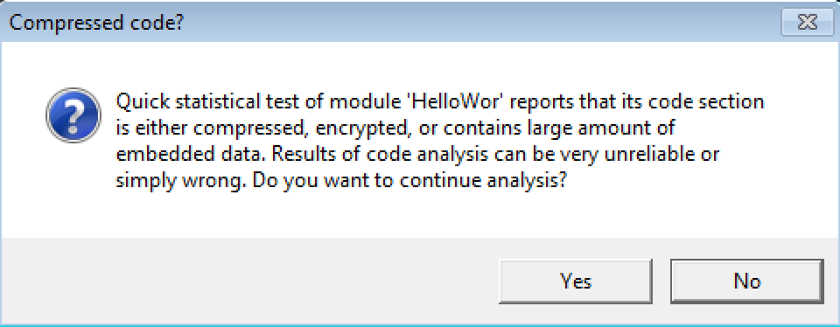
NewPE

Slide 29
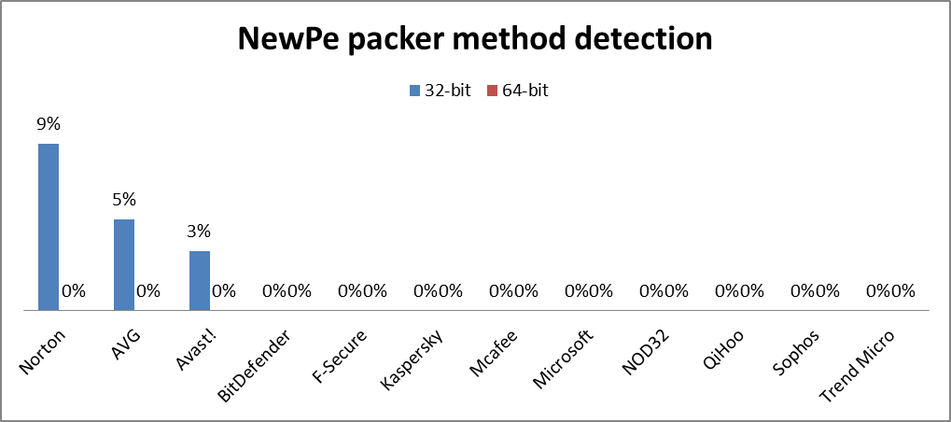
NewPE

Slide 30
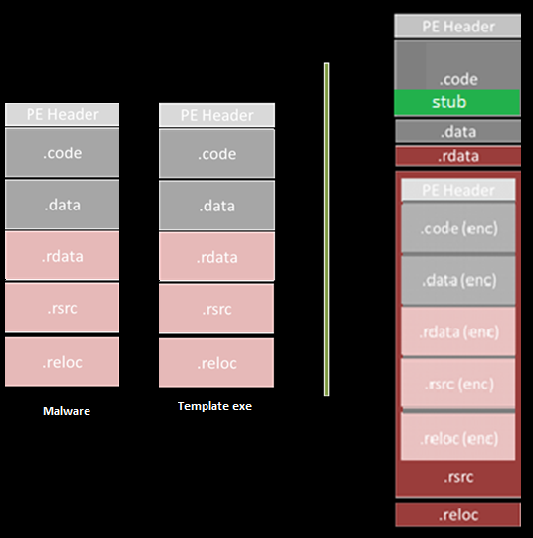
Resource

Slide 31
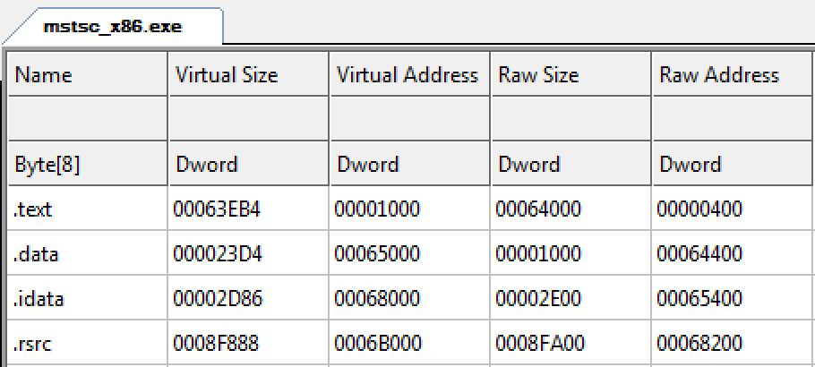
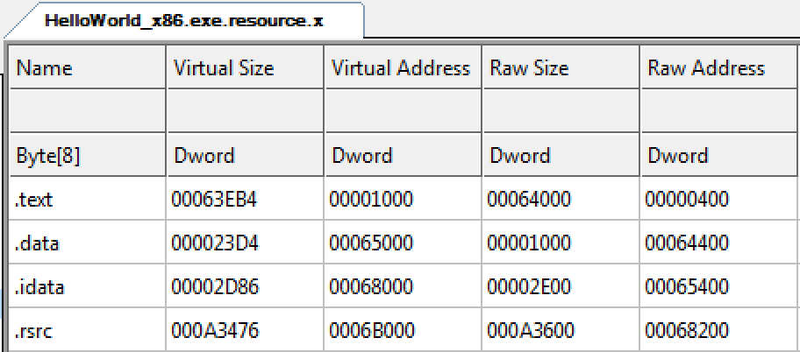
Resource

Slide 32
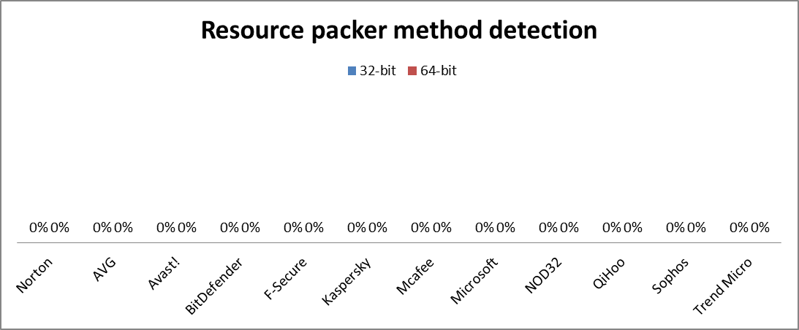
Resource

Slide 33
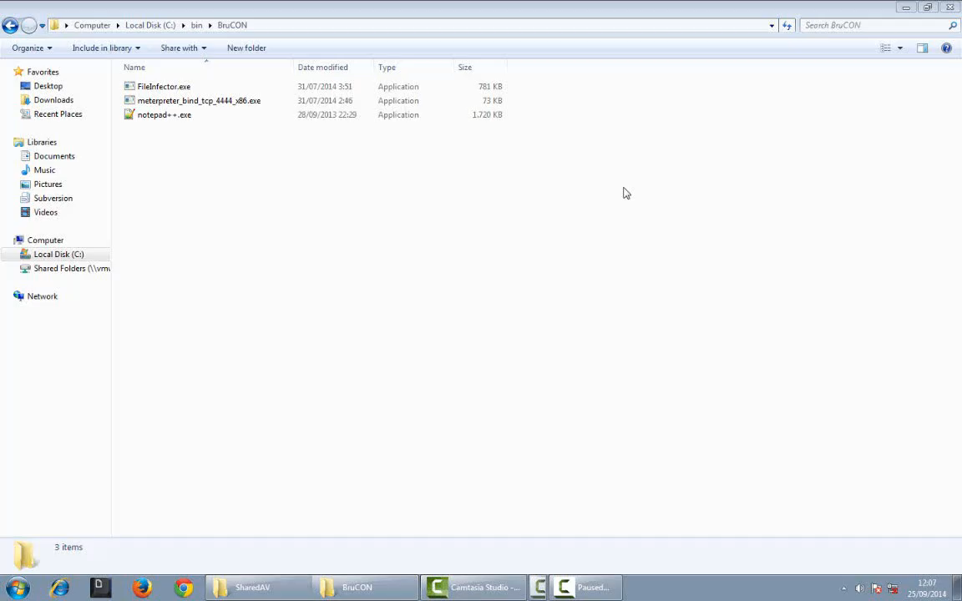

Slide 34
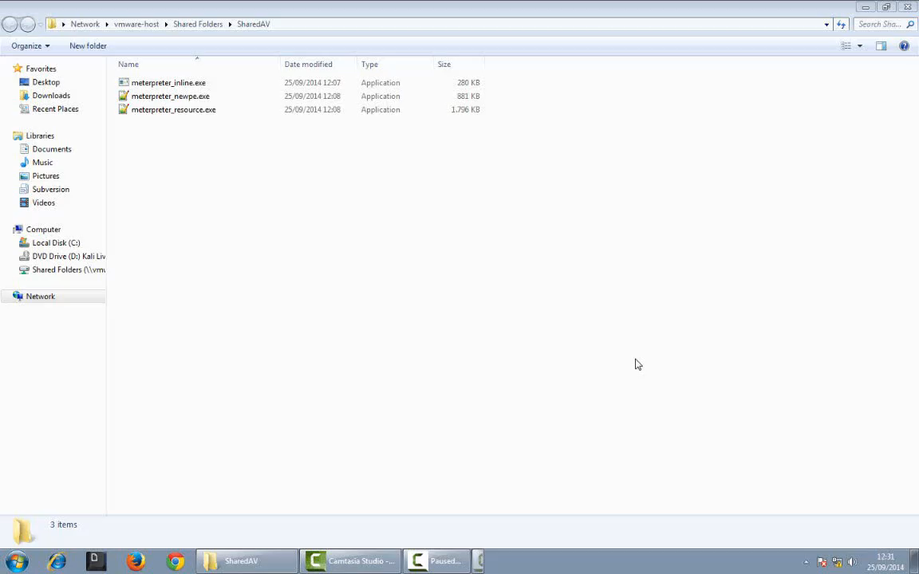

Slide 35
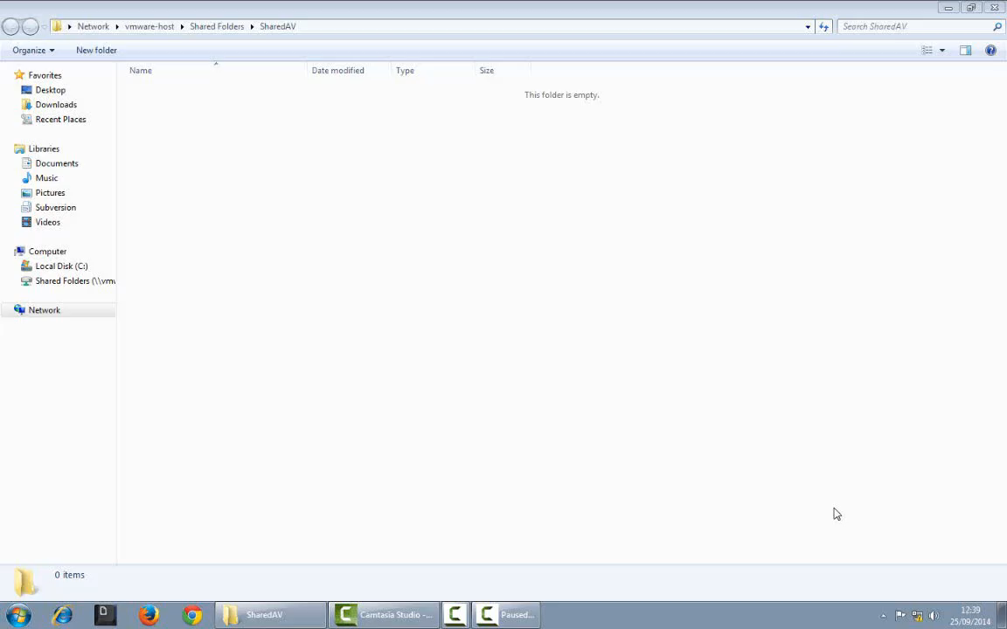

Slide 36
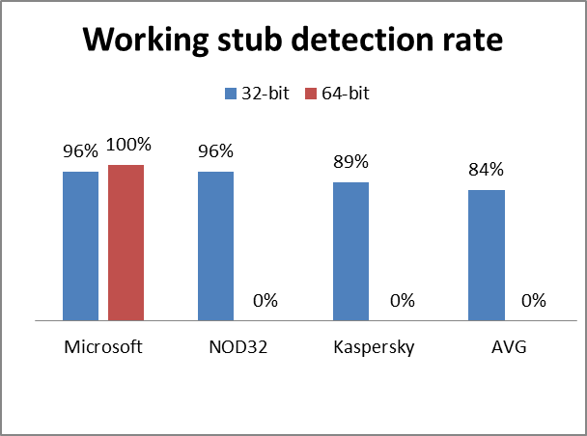
Code emulation detection

Slide 37
Code emulation AntiVirus detection

Slide 38



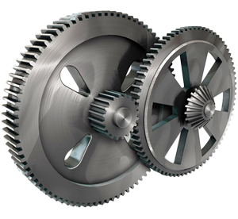

Emulator

Slide 39

Emulated Memory
Emulator

Slide 40
Detection of Packers & Crypters
Performance
Bypass of anti-emulation
Complexity

Slide 41

Method for accelerating hardware emulator used for malware detection and analysis
EP 2237186 B1
System and method for countering detection of emulation by malware EP 2713302 A1
Detecting malicious software by analyzing patterns of system calls generated during emulation
US 6775780 B
System and method for improving the efficiency of application emulation acceleration
EP 2750037 A1
System and method for detecting malware targeting the boot process of a computer using boot process emulation
US 8365297 B1
…

Slide 42
.stub
.malware (encoded)
.allocated memory

Slide 44
W^X

Slide 45
Run 1: track writable memory
Run 2: track writable & executable memory
R-X
R-X
R-X
R-X
RWX
RWX
remove Write right & handle exception
remove Execute right & handle exception

Slide 46
Unpack1
Unpack2
Unpack3
Malware
Naïve automated unpacker
Scan
Scan
Scan
Call WriteFile
OmniUnpack
Scan

Slide 47
Call WriteFile
Fake unpack1
Real Unpack
Malware
Call WriteFile
Fake unpack1
Scan
Real Unpack
Malware

Slide 48
Inst.1
Inst.2
Inst.3
Emulator
Inst.4
…
…
…
…
Inst.N
Analyzer

Slide 49
Separation of Instruction Emulation and System Call Emulation
Inst.1
Inst.2
System Call Emulator
Inst.3
Instruction review Module
Inst.4
Standard Emulator
…
…
…
…
Inst.N
Analyzer

Slide 50
Separation of Instruction Emulation and System Call Emulation
Inst.1
Inst.2
System Call Emulator
Inst.3
Instruction review Module
Inst.4
Standard Emulator
…
Cache Native-Code acceleration / Unpacker routine
…
…
…
Inst.N
Analyzer

Slide 51
Separation of Instruction Emulation and System Call Emulation
Inst.1
Inst.2
System Call Emulator
Inst.3
Instruction review Module
Inst.4
Standard Emulator
…
Cache Native-Code acceleration / Unpacker routine
…
…
…
Hardware Accelerator
Inst.N
Analyzer
Execution in user mode, native system

Slide 52
Time delaying & Anomaly Detection
Filesystem Interaction
Network Interaction
Dynamic Binary Instrumentation

Slide 53
Time 1
BOOL time1(){
//simply sleeps for a long time to delay payload decryption
Sleep(100000);
return FALSE;
}

Slide 54
Time 2
BOOL time2() {
DWORD tc1, tc2;
tc1 = GetTickCount();
Sleep(1000);
tc2 = GetTickCount();
tc2 = tc2-tc1;
//DebugBreak();
if(tc2 >= 1000)
{
return FALSE;
}
return TRUE;
}

Slide 55
thread_1_counter
thread_2_watcher

Slide 56
Cnt=10
Cnt=3
Cnt=2
Cnt=1
Cnt=0
9
8
7
2
1
0
Sleep(10)
If Cnt==10
Sleep(100)

Slide 57
Cnt=0
Sleep(1)
If Cnt==10
Sleep(1)

Slide 58
Network 1
...
// Setup our socket address structure
SockAddr.sin_port=htons(445);
SockAddr.sin_family=AF_INET;
SockAddr.sin_addr.s_addr = inet_addr("127.0.0.1");
// Attempt to connect to server
if(connect(Socket,(SOCKADDR*)(&SockAddr),sizeof(SockAddr))!=0)
{
WSACleanup();
return TRUE;
}
Credits: @FunOverIP

Slide 59
Filesystem 3
...
for(int i=0; i<(sizeof(realDLL)/sizeof(*realDLL)); i++) {
//printf("%s\n", realDLL[i]);
hInstLib = LoadLibraryA( realDLL[i] );
if(hInstLib == NULL) return TRUE;
FreeLibrary(hInstLib);
}
for(int i=0; i<(sizeof(falseDLL)/sizeof(*falseDLL)); i++) {
//printf("%s\n", falseDLL[i]);
hInstLib = LoadLibraryA( falseDLL[i] );
if(hInstLib != NULL)
return TRUE;
}

Slide 60
Filesystem 4
BOOL fs4() {
//MessageBox(NULL, "Fs4", "Fs4", 0);
if(waveInStop(NULL) != MMSYSERR_INVALHANDLE )
return TRUE;
BOOL result = CancelIoEx(NULL, NULL);
DWORD error = GetLastError();
if(!(result == 0 && error == ERROR_INVALID_HANDLE))
return TRUE;
return FALSE;
}

Slide 61
Binary Instrumentation 1
...
GetNameByPid(procentry.th32ParentProcessID, ProcName, sizeof(ProcName));
if(strcmp("explorer.exe", ProcName) && strcmp("cmd.exe", ProcName))
return TRUE;
else
return FALSE;
...
Credits: Francisco Falcón and Nahuel Riva

Slide 62
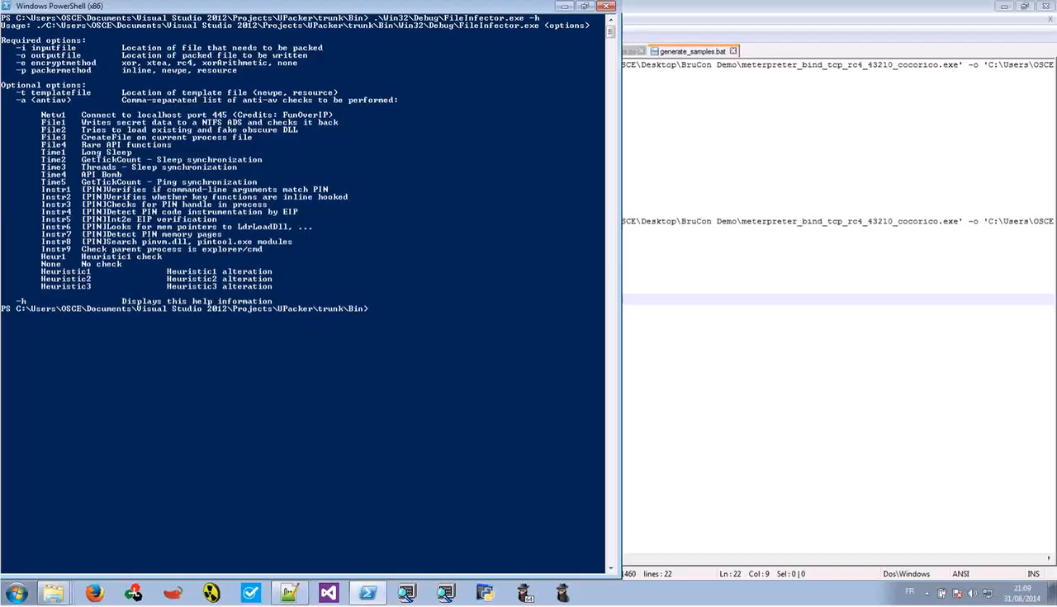

Slide 63
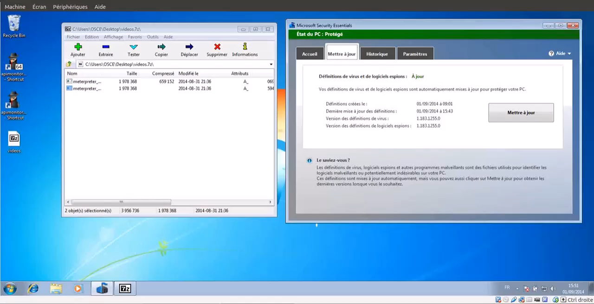

Slide 64
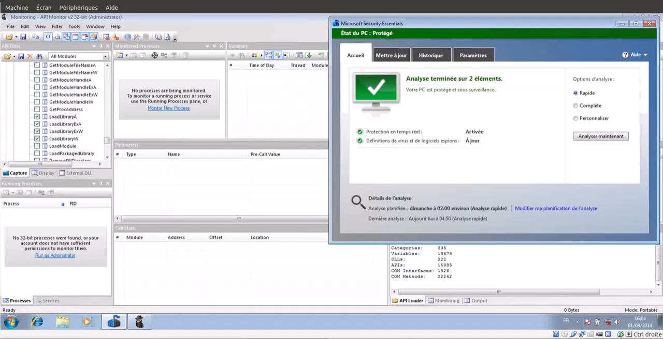

Slide 66
Heuristic/Dynamic Antivirus detection

Slide 67


Slide 68



Slide 69





USER LAND
Kernel32.dll
CreateFileW
Ntdll.dll
…
SSDT
KERNEL LAND
ZwCreateFileW
Procmon.sys

Slide 70
DWORD dwResult = NtUnmapViewOfSection(
pProcessInfo->hProcess,
pPEB->ImageBaseAddress);
...
PVOID pRemoteImage = VirtualAllocEx(
pProcessInfo->hProcess,
pPEB->ImageBaseAddress,
pSourceHeaders->OptionalHeader.SizeOfImage,
MEM_COMMIT | MEM_RESERVE,
PAGE_EXECUTE_READWRITE);
...
WriteProcessMemory(
pProcessInfo->hProcess,
pPEB->ImageBaseAddress,
pBuffer,
pSourceHeaders->OptionalHeader.SizeOfHeaders,
0);

Slide 71


Slide 72


Slide 73
Before
..[SNIP]..
RegOpenKeyExW(hKey, lpSubKey, ulOptions, samDesired, phkResult);
..[SNIP]..
After
char lcCommand[256];
if(*(rrs->hRegKeyRes) == hKey){
if(rrs->hRegKey == HKEY_CLASSES_ROOT)
sprintf_s(clClass, "%s", "HKCR");
..[SNIP]..
if(dwType == REG_NONE)
{
sprintf_s(clType, "%s", "REG_NONE");
}
..[SNIP]..
sprintf_s(lcCommand, "reg add %s\\%ws /v \"%ws\" /t %s /d \"%ws\" /f", clClass, rrs->lpKeyName, lpValueName, clType, lpData);
system(lcCommand);

Slide 74
DWORD dwResult = NtUnmapViewOfSection(
pProcessInfo->hProcess,
pPEB->ImageBaseAddress);
...
NtUnmapViewOfSection(…)
VirtualAllocEx(…)
VirtualProtect(…)
WriteProcessMemory(…)
VirtualAllocEx(…)
...
PVOID pRemoteImage = VirtualAllocEx(
pProcessInfo->hProcess,
pPEB->ImageBaseAddress,
pSourceHeaders->OptionalHeader.SizeOfImage,
MEM_COMMIT | MEM_RESERVE,
PAGE_EXECUTE_READWRITE);
...
NtUnmapViewOfSection(…)
VirtualAllocEx(…)
VirtualProtect(…)
WriteProcessMemory(…)
VirtualAllocEx(…)
...

Slide 75
 | Generic | Complexity | Performance
API Translation
API Junk Injection
Yours here … ???

Slide 76
Evolution of detection methods
Code Emulation is Powerful but Complex
Heuristic is Powerful and could be difficult to bypass in a generic approach
Need to explore new avenues: Machine Learning, Cloud based AV, …

